Slide 1

GLAUCOMA DETECTION USING
DEEP LEARNING
POTTI SRIRAMULU CHALAVADI MALLIKARJUNA RAO
COLLEGE OF ENGINEERING & TECHNOLOGY
BATCH –O7 Under The Guidance of Mrs. V. NAVYA SREE, M. Tech., (Ph. D)
Associate Professor, CSE
PROJECT ASSOCIATES
B. SRAVANA KUMARI (19KT1A0509)
A. SAI HITESH YADAV (19KT1A0506)
M. TEJASWINI (19KT1A0539)
M. SAI KUMAR (19KT1A0534)

Slide 2
Contents
Abstract
Introduction
Motivation
Literature Survey
Research Gaps
Problem Statement
Objectives of the study
System Analysis
Dataset description
System Design
Methodology
Testing
Results
Conclusion
References

Slide 3
Abstract
Glaucoma is the term used to describe either the accumulated loss of retinal cells inside the optic nerve or the gradual visual loss brought on by optic neuropathy. Glaucoma is a disease that relates to the vision of the human eye. This disease is considered an irreversible disease that results in vision deterioration. They don't have any early warning indications of this glaucoma. We might not notice a change in your vision because the effect is so subtle. Many deep learning (DL) models have been developed for the proper detection of glaucoma so far. So, we present an architecture for proper glaucoma detection based on deep learning by making use of the convolutional neural network (CNN). The differentiation between the patterns formed for glaucoma and non-glaucoma can find out with the use of CNN. The CNN provides a hierarchical structure of the images for differentiation. Utilizing the current method, the sickness is detected. Whether a patient has glaucoma or not is determined by the optic cup to the disc ratio. The diagnosis is enhanced by the integration of an image data generator method of data augmentation. The outcomes demonstrate that the proposed model, which outperformed many other existing algorithms, attained 98.47% accuracy.

Slide 4
Introduction
A glaucoma is a group of eye diseases that result in damage to the optic nerve (or retina) and cause vision loss. Risk factors for glaucoma include increasing age, high pressure in the eye, a family history of glaucoma, and use of steroid medication. About 70 million people have glaucoma globally, with about two million patients in the United States. It is the leading cause of blindness in African Americans. It occurs more commonly among older people, and closed-angle glaucoma is more common in women.
Glaucoma has been called the "silent thief of sight" because the loss of vision usually occurs slowly over a long period. Screening for glaucoma is usually performed as part of a standard eye examination performed by optometrists and ophthalmologists. Testing for glaucoma includes measurements of the intraocular pressure using tonometry, anterior chamber angle examination, or gonioscopy as well as an examination of the optic nerve to discern visible damage, changes in the cup-to-disc ratio, rim appearance, and vascular change. Glaucoma detection helps to detect glaucoma from fundus image of their eye.

Slide 5
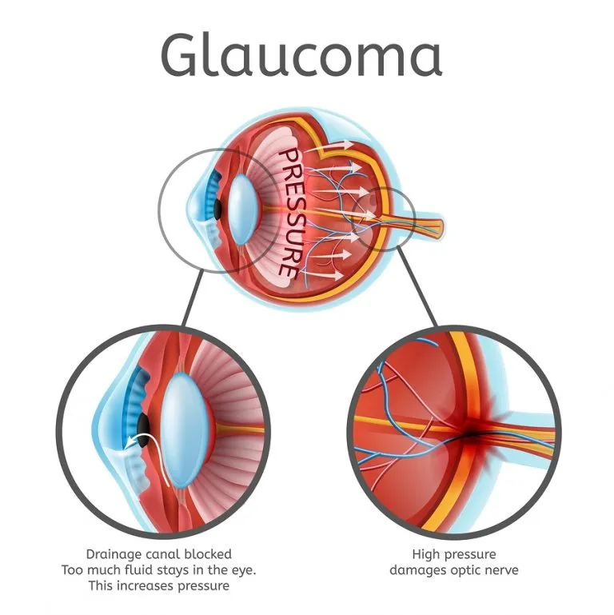
Fig 1: How Glaucoma is caused

Slide 6
Motivation
Being the second largest cause of blindness worldwide, it can lead the person towards complete blindness if an early diagnosis does not take place. Concerning this underlying issue, there is an immense need of developing a system that can effectively work in the absence of excessive equipment, skilled medical practitioners and also is less time consuming. As a result, clinicians in rural areas can also be able to efficiently use this application for their diagnosis. As glaucoma diagnosis is a time-consuming procedure and requires skilled professionals, no special skills are required to work with developed applications

Slide 7
Literature Survey
S.No | Authors | Findings | Technique | Limitations
1 | Ruben Hemelings, Bart Elen, Joao Barbosa‑Breda, Matthew B. Blaschko, Patrick De Boever & Ingeborg Stalmans | modified the training images in a standardized manner, this study revealed a recurrent pattern in inferotemporal and superotemporal regions neighboring the ONH and the ONH itself. | classification CNN | The proposed model did not explicitly assess the influence of myopic changes, did not analyze the role of the disease stage.
2 | Naganagouda Patil1 & Preethi N. Patil & P. V. Rao | Image size is the first evaluation with learning rate of 0.1, 0.01, 0.001 and 0.0001. The high performance is achieved with 0.001 learning rate. | deep learning (DL), with deep-belief network (DBN) | Dataset used is an unbalanced dataset totally 20.92% glaucoma images together with 79.08% normal images are used.

Slide 8
Literature Survey
3 | Oluwatobi Joshua Afolabi , Gugulethu P. Mabuza-hocquet , Fulufhelo V. Nelwamondo, And Babu Sena Paul | The use of CDR threshold of 0.6 may only be suitable for this database. It was found out that extracting 5 features did not give a full view of the changing geometry of the optic cup and disc and extracting more than ten (10) features only resulted into duplication of data | U-Net Lite and Extreme Gradient Boost (XGB) | The proposed model does not works on low quality images.
4 | Wang Min Liao, BeiJi Zou, RongChang Zhao, Yuan Qiong Chen, ZhiYou He, and MengJie Zhou, | The researchers observed that the result of glaucoma diagnosis is improved with the increasing of optic disc segmentation,removed batch normalization layers and drop out reduced to 0.2 to reduce the overfitting model. | novel clinical interpretable ConvNet architecture (EAMNet) | This model is worked on ORIGA dataset which is unbalanced dataset because it contains 168 glaucomatous and 482 normal fundus images.

Slide 9
Literature Survey
5 | Guangzhou An, Kazuko Omodaka, Kazuki Hashimoto, Satoru Tsuda, Yukihiro Shiga, Naoko Takada,Tsutomu Kikawa, Hideo Yokota, Masahiro Akiba and Toru Nakazawa | The machine learning system described can accurately differentiate between healthy and glaucomatous subjects based on their extracted images from OCT data and color fundus images. | optical coherence tomography and Transfer learning of convolutional neural network | This study include a relatively small study population.

Slide 10
Research Gaps
There are some research gaps in the papers, we reviewed. So, We are trying to overcome some of the gaps in our proposed model. It is also important to get the best results with the model we propose. Some of the research gaps are mentioned below.
Many researchers used Small size dataset which led them underfitting of their model.
Many researchers didn’t consider the poor quality images (contrast, cropping) and they are removed as noise.
Existing models are somehow able to detect the presence of Glaucoma but fail to identify the Stage of Glaucoma
Researchers used RGB images so when red channel is used, retinal image are most affected.
The papers we reviewed had the most unbalanced datasets which lead to improper training and effected the truthfulness of the system.

Slide 11
Problem Statement
The eyes are important sensory organs that provide sight. Glaucoma is a neuro-degenerative eye disease developed due to an increase in the Intraocular Pressure inside the retina. When the cup-to-disc ratio is greater than the normal range, the patient’s eye is suspected a glaucomatous eye. Doctors need to perform many tests such as Ophthalmic tests, Tonometry, Ophthalmoscopy, Perimetry, Pachymetry, and Gonioscopy. After getting results from a different test, the doctor has to decide whether it is a glaucomatous eye or not. Careful evolution is important to detect glaucoma and there is a high chance of not getting accurate results due to a lack of skill. Being the second largest cause of blindness worldwide, it can lead the person towards complete blindness if an early diagnosis does not take place. With respect to this underlying issue, there is an immense need of developing a system that can effectively work in the absence of excessive equipment, and skilled medical practitioners and also is less time-consuming.

Slide 12
Objectives of the Study
The major objective of this study is to improve the concept of prediction of glaucoma disease with the help of augmentation techniques.
Developing a robust system by training the model with different kinds of datasets containing varied characteristics of fundus images and increasing the number of training and testing images.
The proposed approach is applied to large datasets.
The proposed data augmentation technique is the usage of image data generator.
Instead of using RGB images we use binarization as it results in higher classification with less memory consumption.
Using CNN for feature extraction and classification to achieve higher accuracy results.

Slide 13
System Analysis
System Analysis is the process of analyzing a system with the potential goal of improving or modifying the system. An analysis is breaking down the problem into smaller elements for study and ultimately providing a better solution. During the process of system development, Analysis is an important aspect. This involves gathering and interpreting facts, diagnosing the problem, and using the information to recommend improvements to the system. Ultimately, the goal is to give a computerized solution.
1. System study
2. Requirements analysis
3.System requirements specification
4.Project model (Agile model)

Slide 14
System Analysis
The System Requirements Specification (SRS) begins the translation process that converts the software requirements into the language the developers will use.
Software Specifications
The minimal software specifications of the proposed system are,
Operating System : Windows
Language : Python3
Tools / Libraries : Jupyter/Tensor flow, Keras
Dataset : Image data
Hardware Specifications
The minimal hardware specifications of the proposed system are,
Processor : Intel I5
RAM : 8 GB
Hard Disk : 64 GB

Slide 15
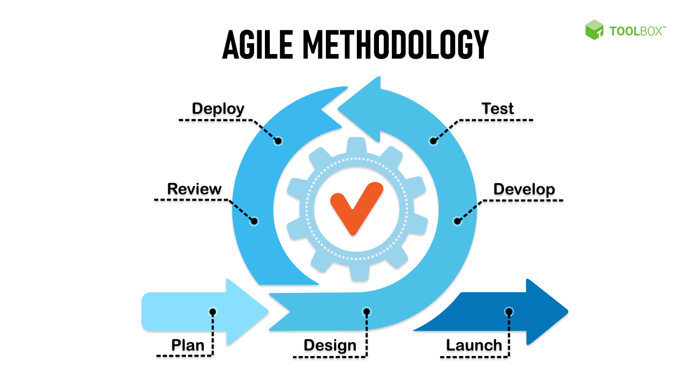
System Analysis Model
Process Model: Agile
Agile project management works off the basis that a project can be continuously improved upon throughout its life cycle, with changes being made quickly and responsively. The Agile methodology enables to re-evaluate their work and make adjustments in small increments. The number of images trained to the model will fluctuate based on the step it is going through. The agile model helps in iterative process to make the required changes from the design phase. In glaucoma detection, we can add a new dataset which does not affect the requirement phase so only changes are made in the design phase.
Fig 2: Agile Model

Slide 16
Dataset Description
ACRIMA
ACRIMA database is composed by 705 fundus images All images from ACRIMA database were annotated by glaucoma experts with several years of experience. They were cropped around the optic disc and renamed.
DRISHTI-GS
This Dataset contains 50 train images and 51 test Images. In Each Directory there are two folders one is images and the second one is GT. The later folder contains Optic Disk and Cup masks associated with the images in the Images folder.
RIMONE
The RIM-ONE database contains 169 optic nerve head images. Each image has 5 manual segmentations from ophthalmic experts. A gold standard for each image was created from its corresponding segmentations.
Datasets drive link:
https://drive.google.com/drive/folders/1F3RTP6LFe95zDNup-e8vXiDuddM0R0K3?usp=share_link

Slide 17
System Design
Finding a general framework of how the problem might be solved comes once the analytical process is complete. The process of system design is starting to transition from the logical to the physical level.
Architecture and intricate system design are both included in system design. Identification of software components, their breakdown into processing modules and conceptual data structures, and the specification of the connections between components are all part of the architectural design process.
There are two distinct methods:
Top down Approach
Bottom up Approach

Slide 18
System Design
Top down Approach
This type of design starts from upper level modules. Since the detailed activities usually performed in the lower level routines are not provided, stubs are written.
Bottom up Approach
Design being performed from smallest and lowest level modules one at a time. For each module in the bottom up approach a short idea is provided in order of the needed approach so that the module is asked to perform the way it will when embedded within the larger system. When bottom level modules are tested attention turns to those on the next level that use the lower level once they are designed individually and then linked with the previously examined lower level modules.

Slide 19

Data Flow diagrams:
Fig.3:Level 0 DFD

Slide 20
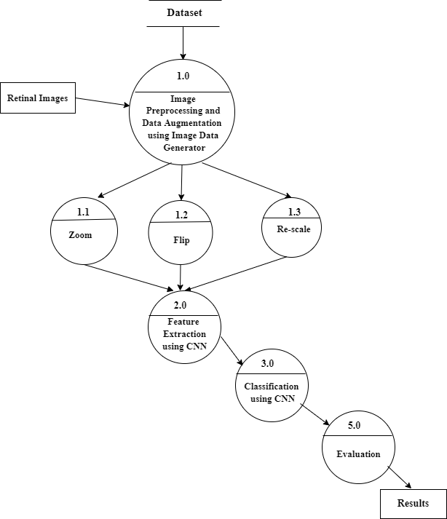
DFD Level 1:
Fig.4:Level 1 DFD

Slide 21
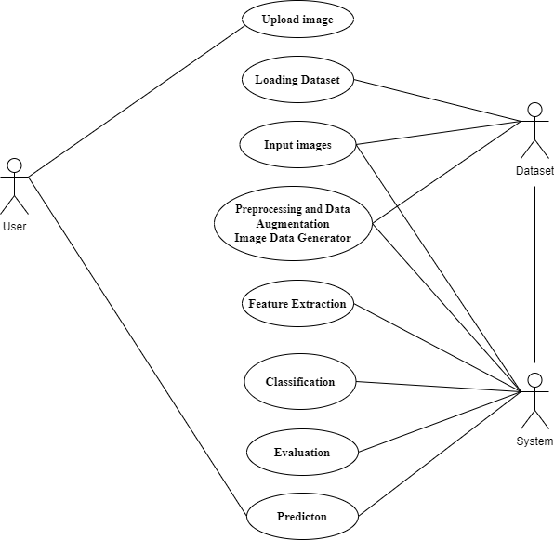
Use case diagram:
Fig.5:Use case diagram

Slide 22
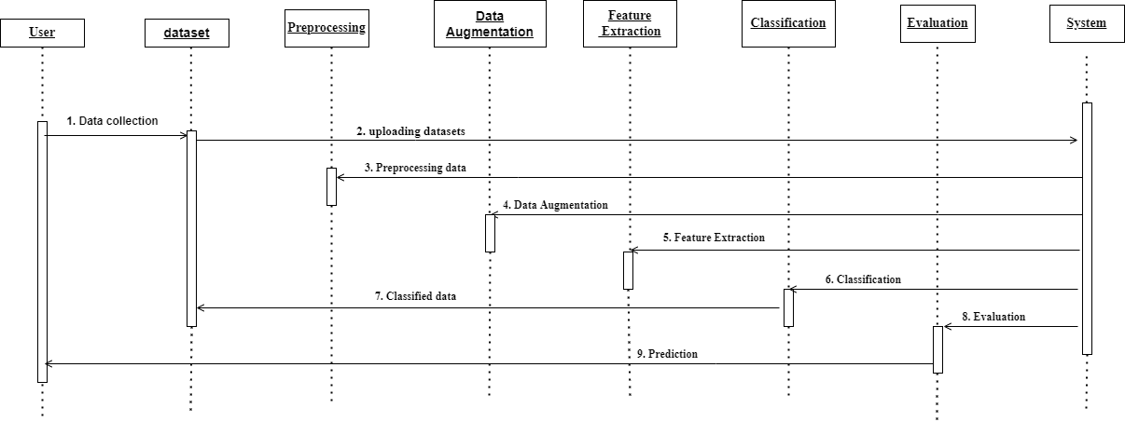
Sequence Diagram:
Fig.6:Sequence diagram for System

Slide 23
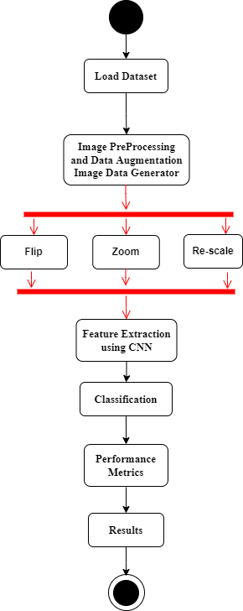
Activity Diagram:
Fig.7:Activity Diagram for System

Slide 24
Methodology
We considered 3 different datasets and combined them to become a large dataset. The primary step of any model building will be pre-processing of the data. The pre-processing of data means converting the raw data into required form so that the analyzation becomes easy. The preprocessing and data augmentation is done by image data generator. The augmented images are then sent for feature selection. In the feature extraction and classification we are using Convolutional neural network. As we know neural networks are composed of many layers like convolution,pooling, fully-connected layers etc., And also have activation functions. CNN takes image as input for training. This may improve the prediction accuracy of the model. Based on the amount of pressure, the stage of the glaucoma can be determined.

Slide 25
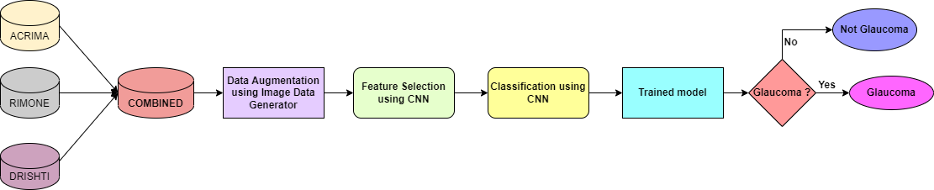
Fig.9: Proposed System

Slide 26
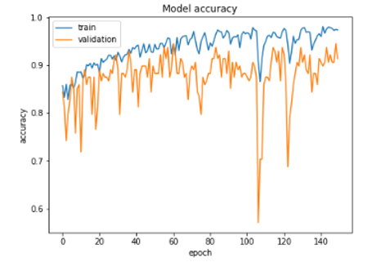
Results
From the figure, we can observe many troughs and depths in the plotted graph. Since we are having 150 epochs, the accuracy at each epoch is plotted in the graph and we can see that after 100 epochs there is a sudden drop in accuracy and when we increase the epochs there we can see a steady increase in the model's accuracy. This will give us a better insight into the model's performance.

Slide 27
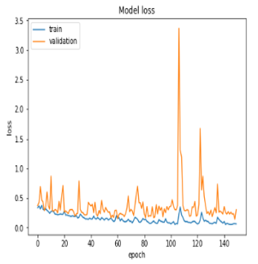
Proposed Model’s loss at each epoch
The figure depicts the different values of loss at each epoch. As we have discussed earlier, there is a sudden drop in the accuracy as the loss function value is varied. This graph of loss function helps us to predict the issues that occur with learning. These issues can lead to underfitting or an overfitted model.

Slide 28
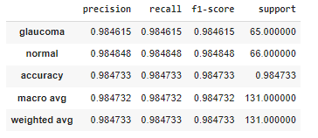
Classification Report
The classification report here instigates the fact that this model which achieved an accuracy of 98.47% with an integrated dataset is to be noted and this is the first ever model to achieve this. All the existing studies have achieved the results by working on small datasets whereas the proposed model has a large dataset. The CNN here can process even on low quality images. The dataset created is a balanced dataset with proportionate number of glaucoma and normal images.

Slide 29
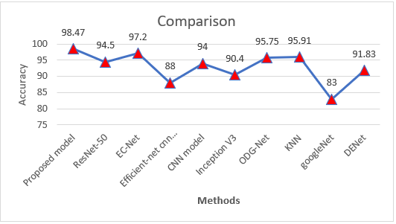
Comparison of proposed model with the existing models
Fig 10:Comparative study of Performance measure(Accuracy).

Slide 30
Testing
Unit Testing
TEST CASE ID | TEST CASE OBJECTIVE | TEST STEPS | EXPECTED RESULT | ACTUAL RESULT | STATUS
1 | Loading the image file with target shape | using “tensorflow.keras.preprocessing.image.load_img” we read image | Image loaded in target shape | Image loaded in target shape | PASS

Slide 31
Integration testing
TEST CASE ID | TEST CASE OBJECTIVE | TEST STEPS | EXPECTED RESULT | ACTUAL RESULT | STATUS
1 | Verify that image is rescaled or not | Using keras.preprocessing.image.ImageDataGenerator images are rescaled | Normalized Images are generated | Normalized Images are generated | PASS
2 | Verify that image is horizontally flipped or not | Using keras.preprocessing.image.ImageDataGenerator images are horizontally flipped | Images are generated | Images are generated | PASS
3 | Verify that image is sheared at a specified angle or not | Using keras.preprocessing.image.ImageDataGenerator images are sheared | Images are generated | Images are generated | PASS
4 | Verify that image is applied using zooming transformation with a specified scale factor | Using keras.preprocessing.image.ImageDataGenerator images are magnified | Images are generated | Images are generated | PASS

Slide 32
Acceptance testing
TEST CASE ID | TEST CASE OBJECTIVE | TEST STEPS | EXPECTED RESULT | ACTUAL RESULT | STATUS
1 | Verify that image is of type jpg,jpeg,png only | JPEG, JPG, PNG | Images are read | The result is as expected | PASS
 |  | Other formats | Error message | The result is as expected | PASS
2 | Verify that image is glaucomatous or healthy | Glaucoma Eye Image | Return output as Glaucomatous Eye | The result is as expected | PASS
 |  | Healthy Eye Image | Return output as Healthy Eye | The result is as expected | PASS

Slide 33
Conclusion
Permanent blindness is brought on by the complication of glaucoma, which is connected to optic nerve damage. The use of glaucoma detection will expand thanks to this method of medical image processing technology. The computer-generated results from this work will help to raise the bar for clinical judgment when it comes to glaucoma identification. Because there are more normal fundus photos in the dataset, this algorithm can detect the glaucomatous images correctly. The proposed methodology uses an image data generator for data augmentation. The original images have increased due to augmentation and a large dataset is prepared. Later the augmented images have been sent for feature selection using CNN. The images are classified using binary classification as it has two outcomes. The proposed system achieved an accuracy of 98. 47% which is noteworthy in this field.

Slide 34
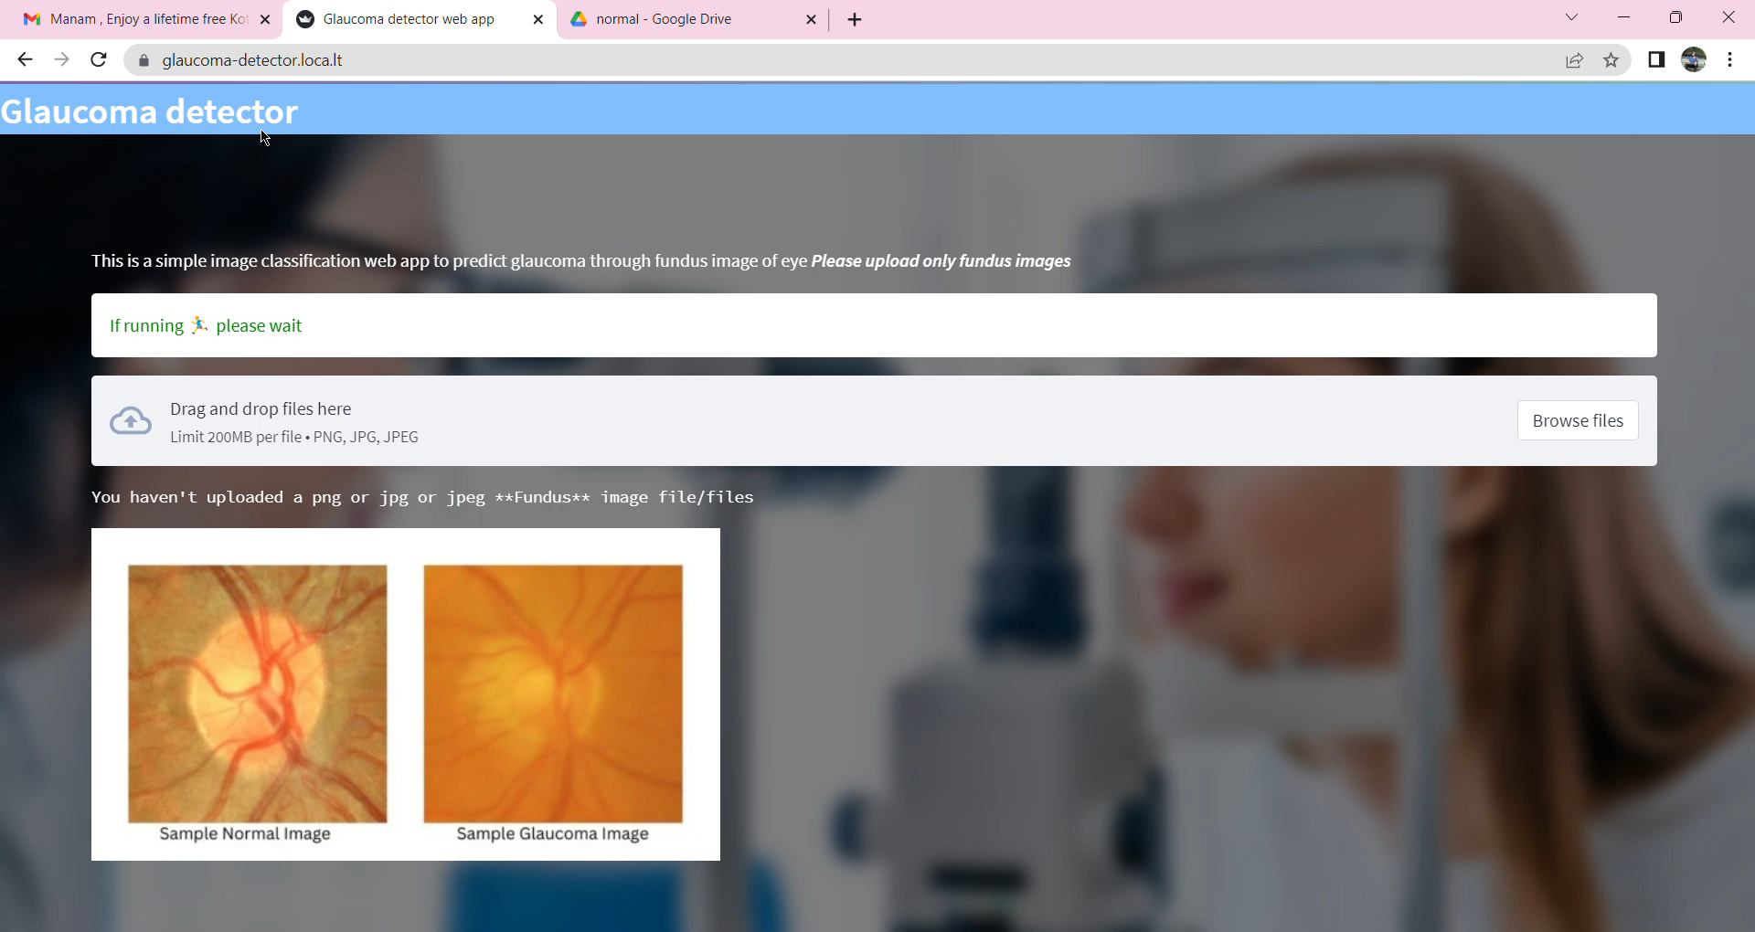
Demo of our work

Slide 35
References
Hemelings, R., Elen, B., Barbosa-Breda, J. et al. Deep learning on fundus images detects glaucoma beyond the optic disc. Sci Rep 11, 20313 (2021). Doi: https://doi.org/10.1038/s41598-021-99605-1
Patil, N., Patil, P. N., & Rao, P. V. (2021). Convolution neural network and deep belief network (DBN) based automatic detection and diagnosis of Glaucoma. Multimedia Tools and Applications, 80(19), 29481–29495. Doi: 10.1007/s11042-021-11087-5.
O. J. Afolabi, G. P. Mabuza-Hocquet, F. V. Nelwamondo and B. S. Paul, "The Use of U- Net Lite and Extreme Gradient Boost (XGB) for Glaucoma Detection," in IEEE Access, vol. 9, pp. 47411-47424, 2021, doi: 10.1109/ACCESS.2021.3068204.
W. Liao, B. Zou, R. Zhao, Y. Chen, Z. He and M. Zhou, "Clinical Interpretable DeepLearning Model for Glaucoma Diagnosis," in IEEE Journal of Biomedical and Health Informatics, vol. 24, no. 5, pp. 1405-1412, May 2020, Doi: 10.1109/JBHI.2019.2949075.
An, Guangzhou, et al. "Glaucoma diagnosis with machine learning based on optical coherence tomography and color fundus images." Journal of healthcare engineering 2019 (2019), Doi: https://doi.org/10.1371/journal.pone.0207982

Slide 36
Thank you

